Slide 1
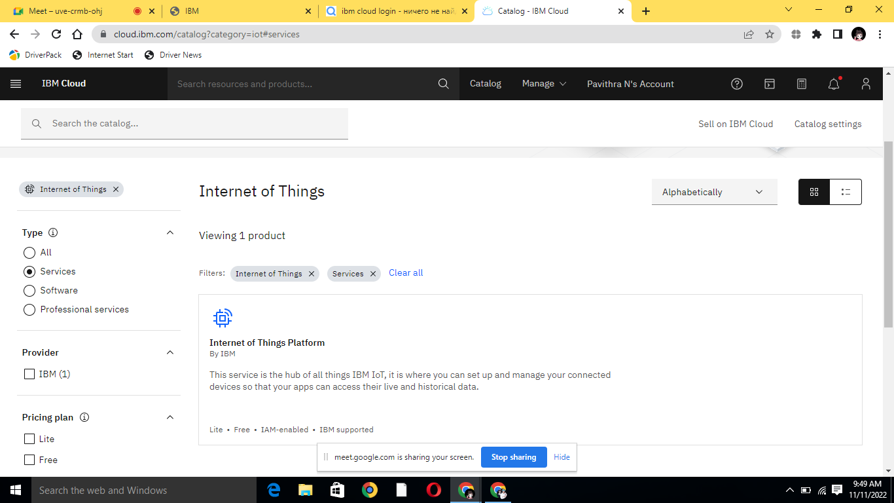
DATE | 11 NOV 2022
TEAM ID | PNT2022TMID48693
PROJECT NAME | Smart waste management system for metropolitan cities
Step1:

Slide 2
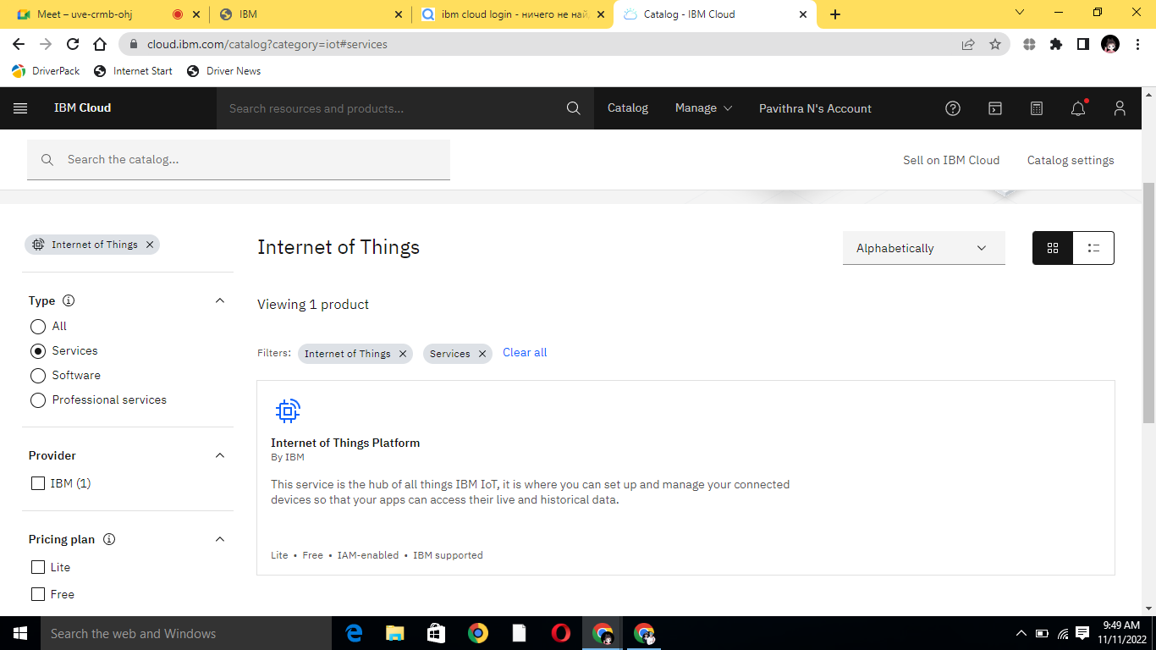
step2:

Slide 3
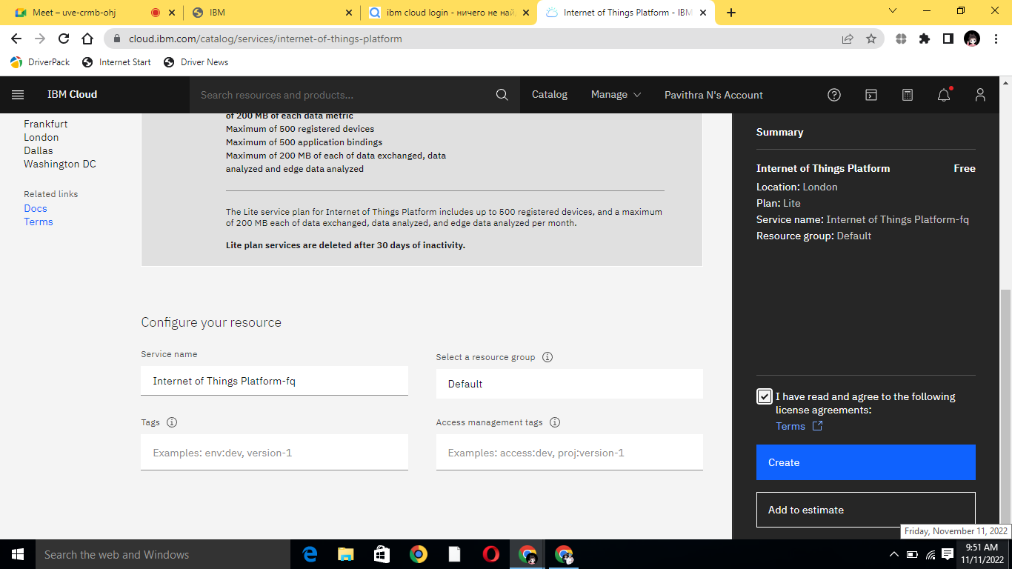
Step3:

Slide 4
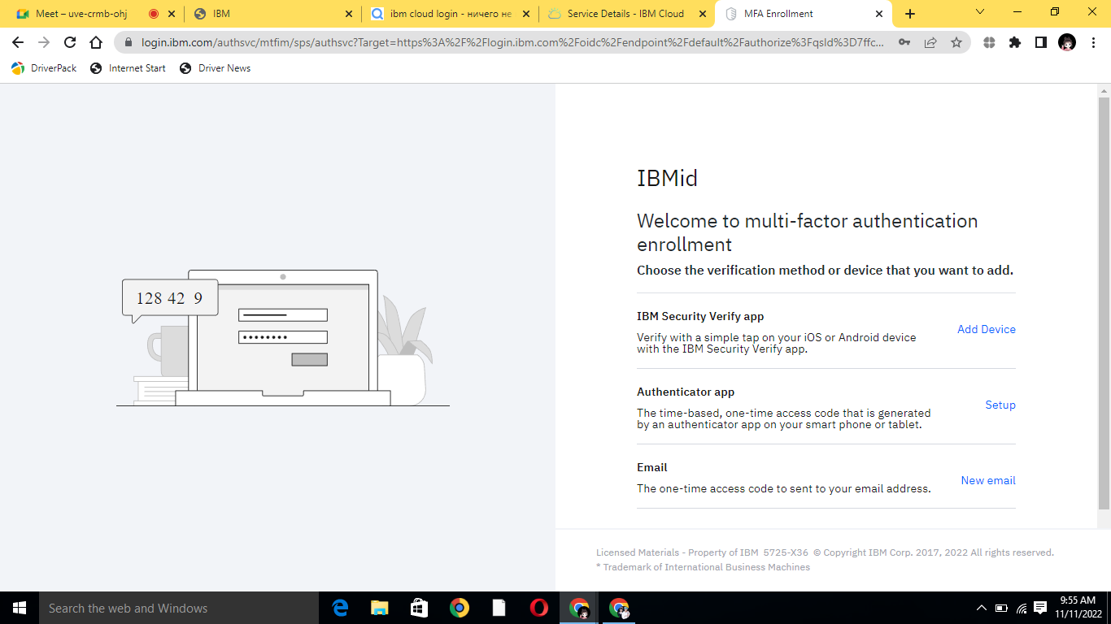
Step4:

Slide 5
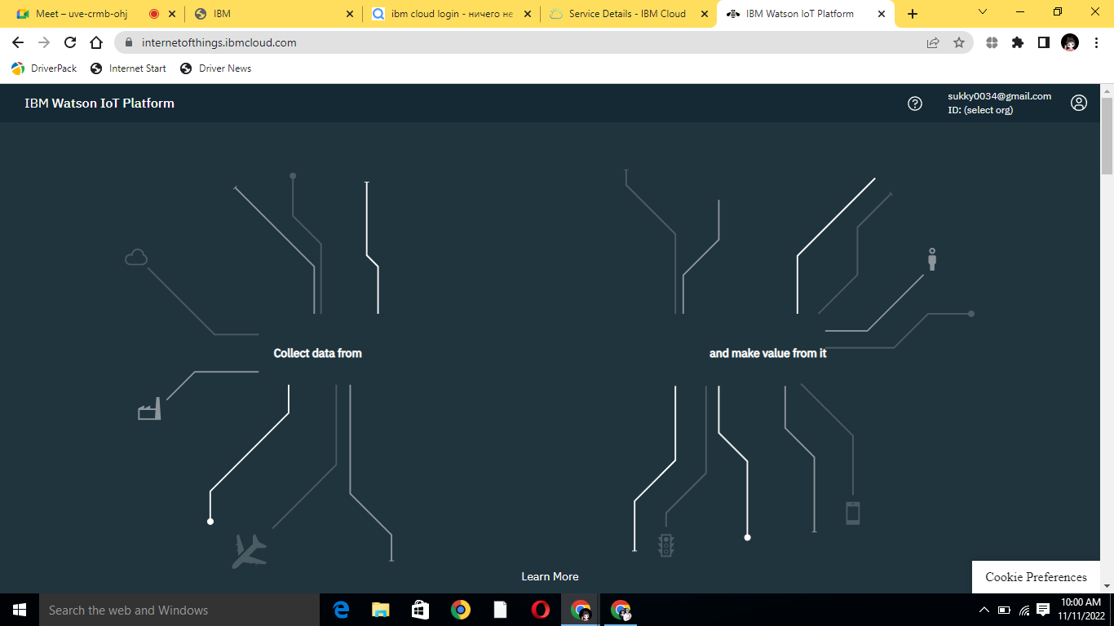
Step5:

Slide 6
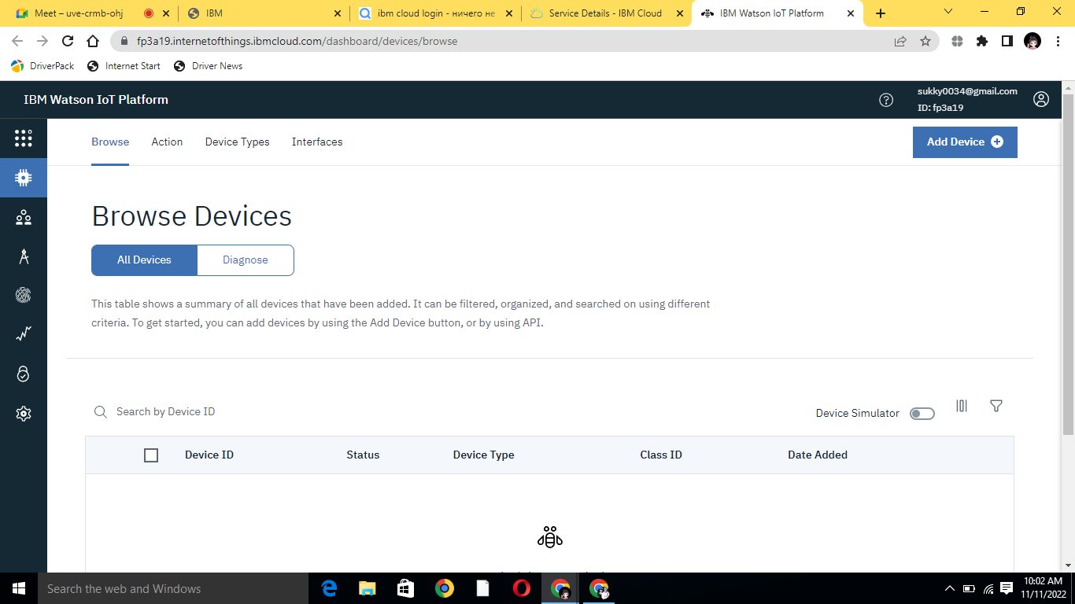
Step6:

Slide 7
Step7:

Slide 8
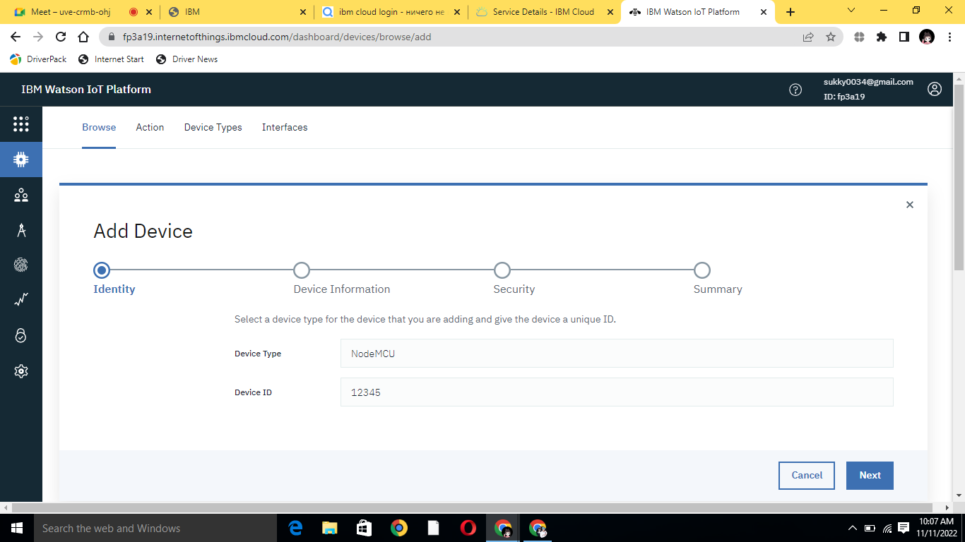
Step8:

Slide 9
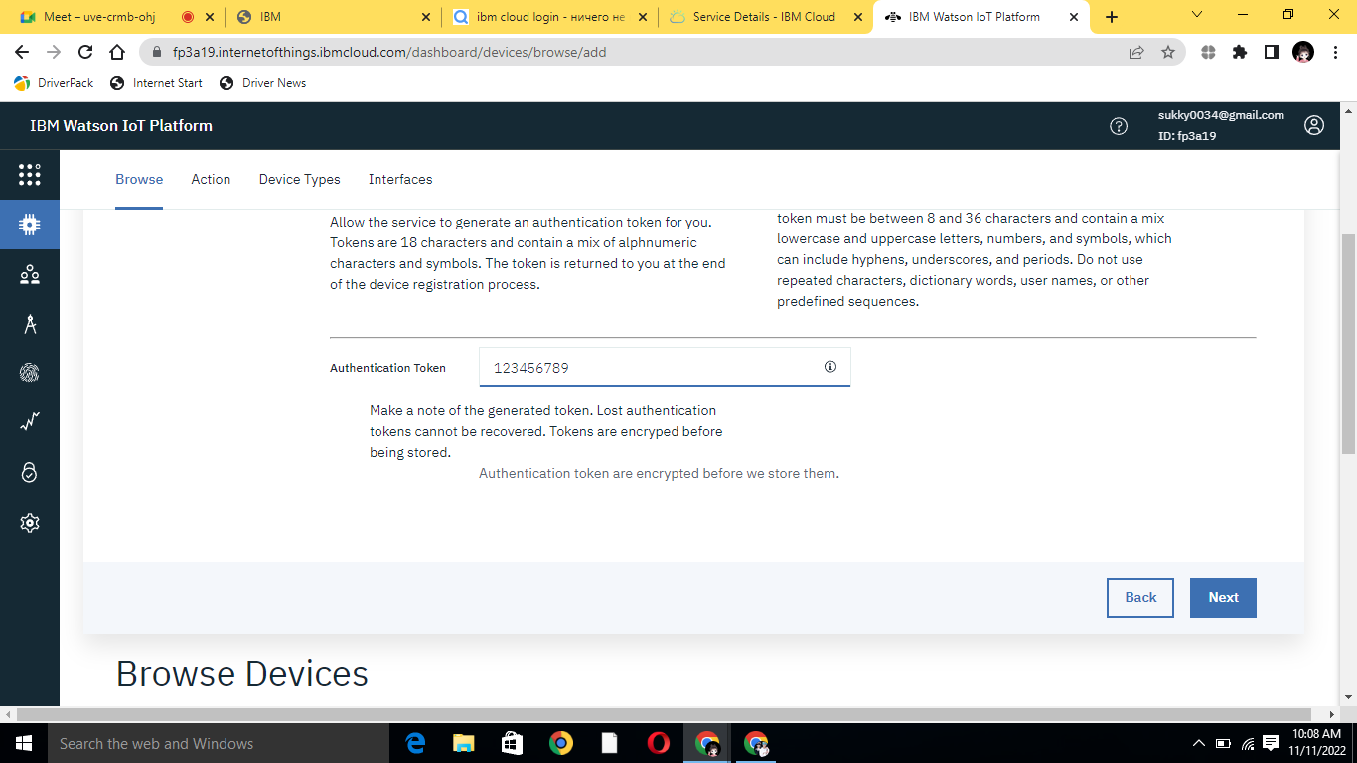
Step9:

Slide 10
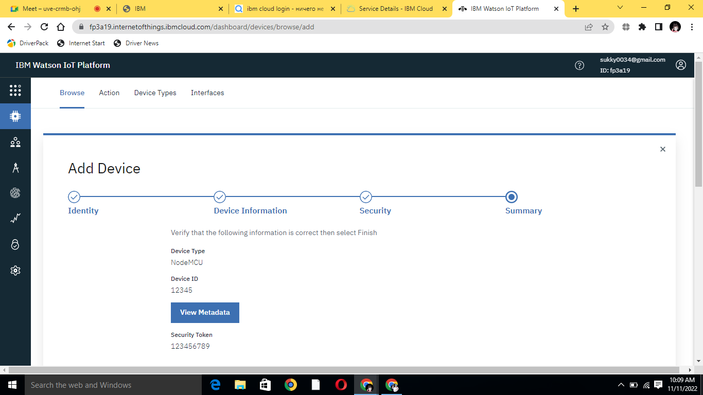
Step10:

Slide 11
Step11:

Slide 12
Step12:

Slide 13
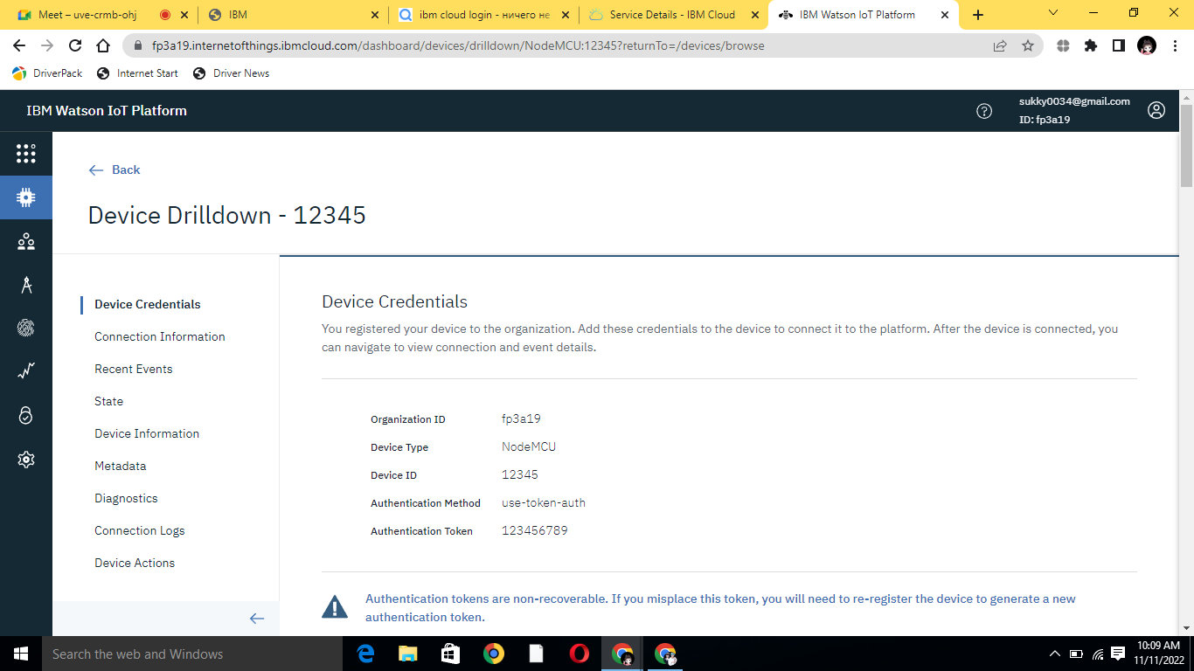
Step13:

Slide 14
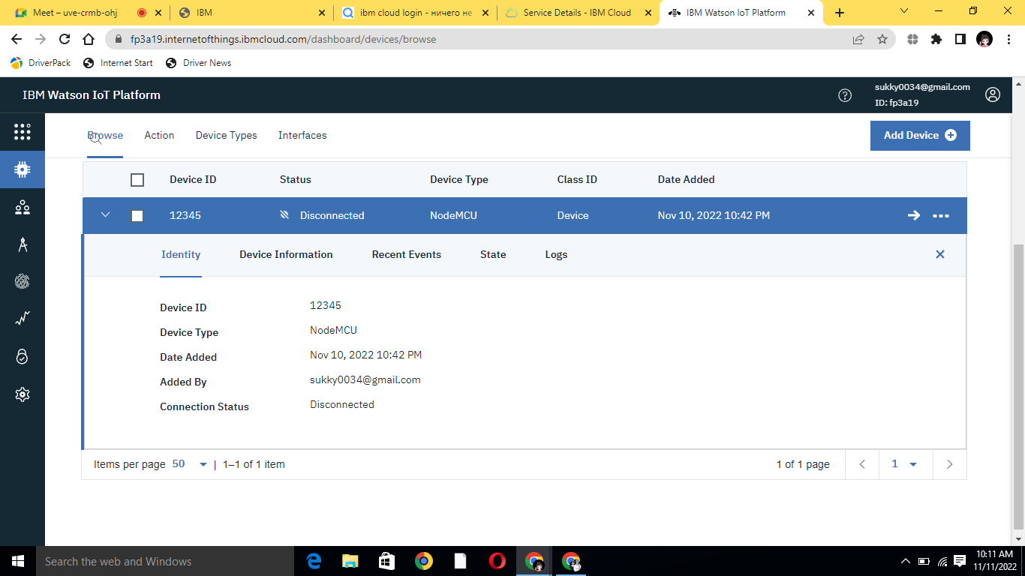
Step14: We created waston successfully

